Slide 1
Urban Freight Delivery
TRB Planning Applications Conference
Annie Nam
Manager of Goods Movement & Transportation Finance
June 2, 2019

Slide 2
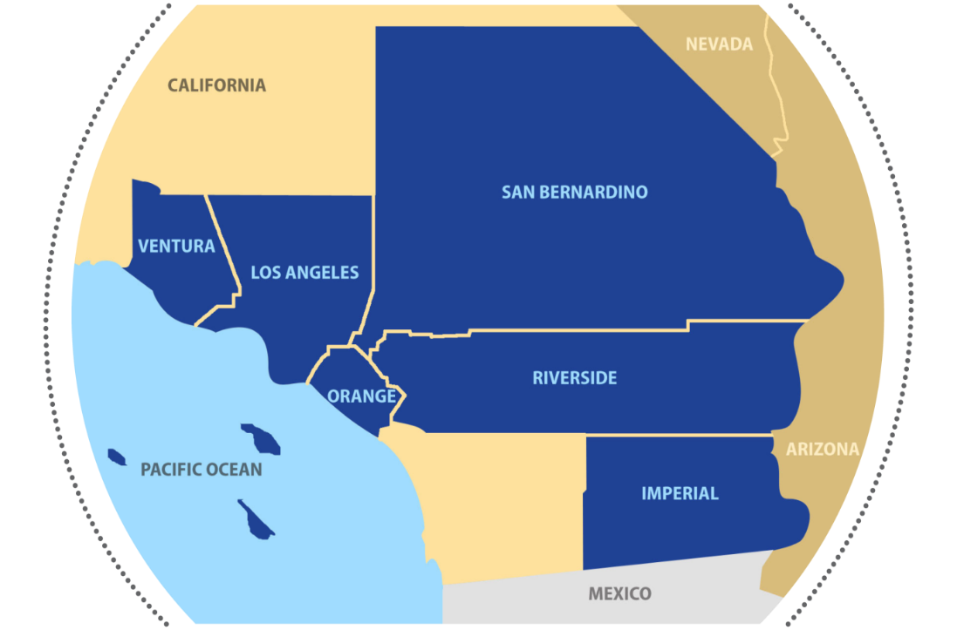

About SCAG
Nation’s largest Metropolitan Planning Organization (MPO)
38,000 Square Miles
15 Subregions
Nation’s Global Gateway for Trade
Address Federal & State Regional Planning Mandates & Local Membership Needs

Slide 3
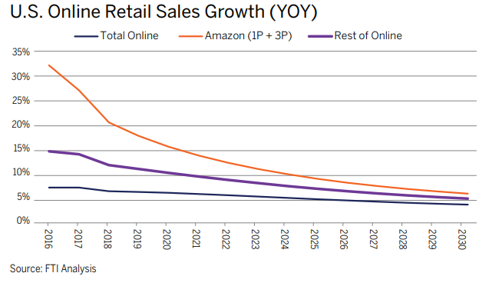
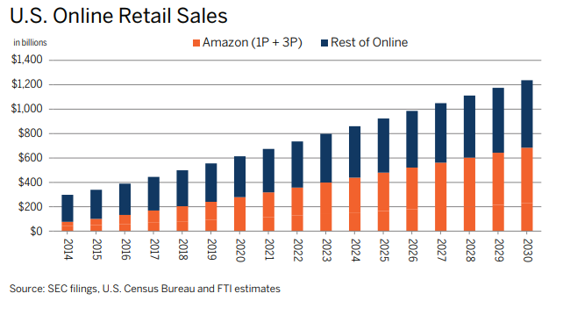
Key Trends
E-Commerce Forecast Expectations

Slide 4
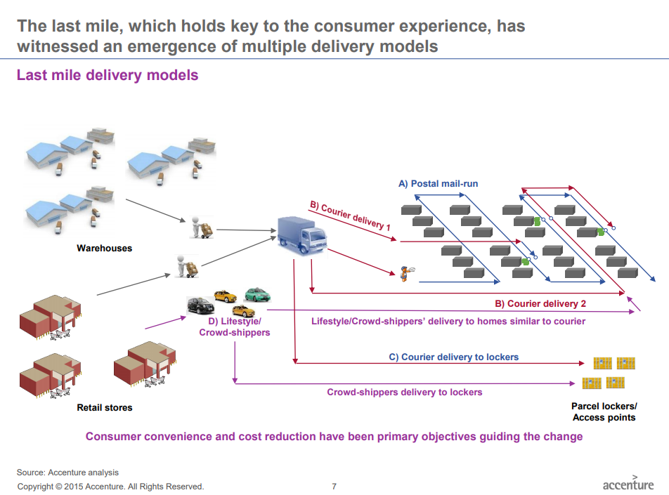
Key Trends

Slide 5


Last Mile Freight Study (LMFS)
  Citywide data analysis
  Stakeholder input
  Field data collection
  Final report and toolbox of strategies
  Pilot project concepts

Slide 6
Citywide Data Analysis
  Defined existing conditions
  Identified case study locations
GIS Screening by Attributes
Mapping Screen Locations and Visually Identify Clusters
Visual Review of Block Clusters
Determined Blocks for Data Collection
90,000 Blocks 605 Screened Blocks 17 Case Studies
(35 blocks)

Slide 7
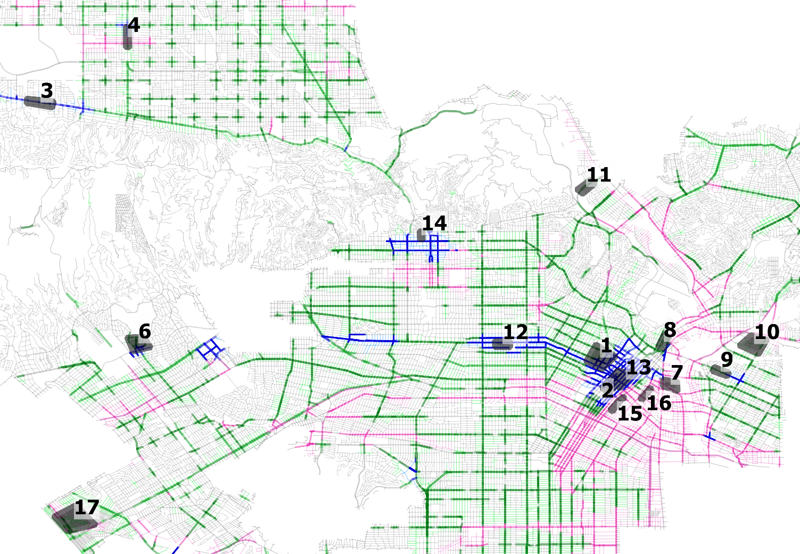
17 Case Study Sites

Slide 8
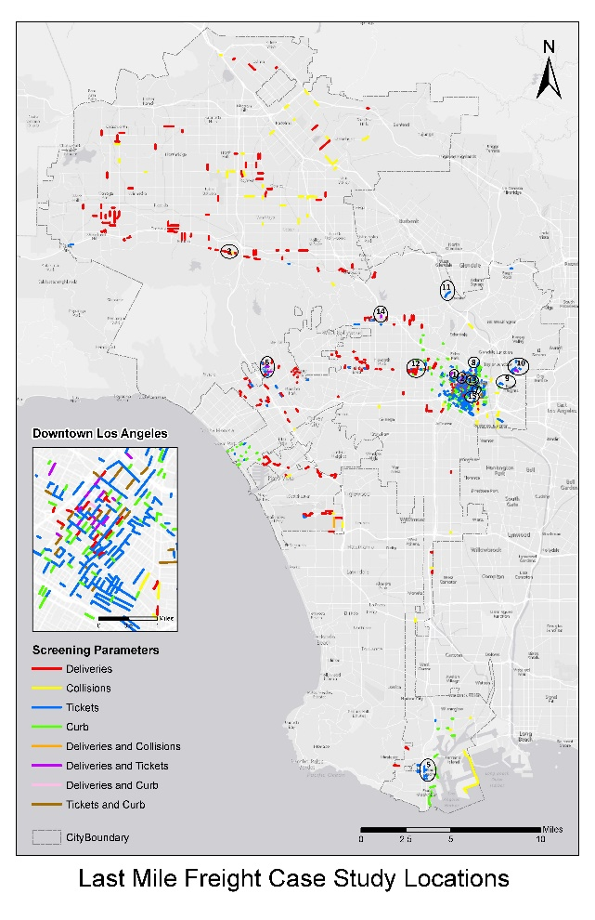
LMFS Place Types

Slide 9
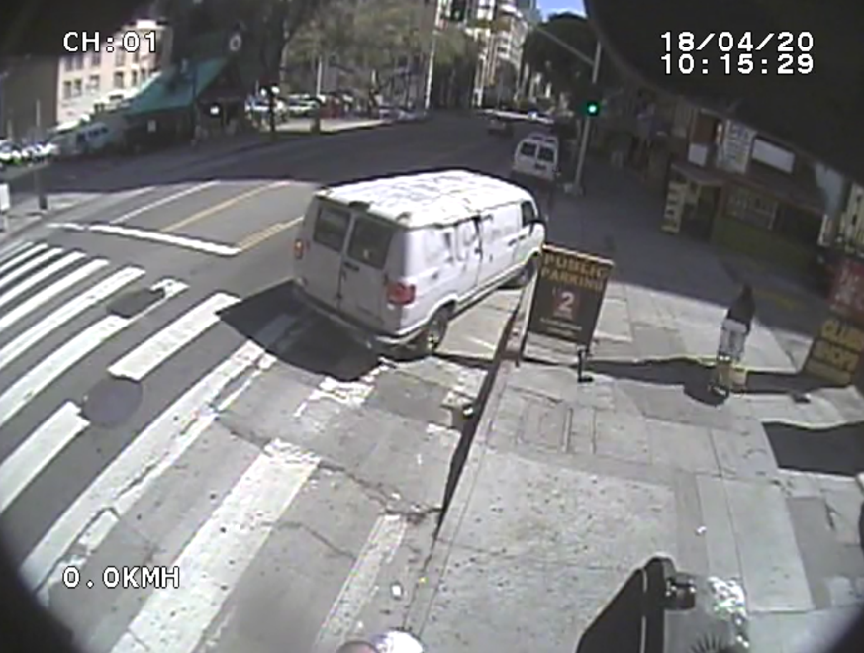
Field Data Collection
Developed processes and methodologies
Conducted pilot collection and analysis
Used mix of technicians and video to collect data at 35 blocks

Slide 10
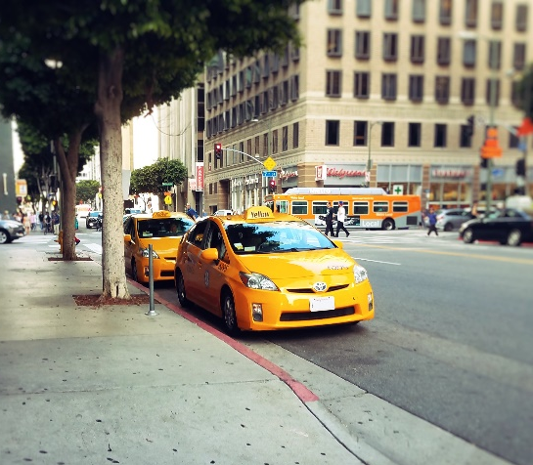
Findings - Field Data Collection
Overall, 8,218 activities at 1,136 curb space slots in 35 blocks were observed.
56.7 percent Parking / Waiting
19.0 percent Bus Loading/Unloading
15.1 percent Passenger Loading/Unloading
9.2 percent Commercial Loading/Utility

Slide 11

LMFS Delivery Vehicle Analysis
Delivery vehicles were 61% of all deliveries – 70% package/parcel (FedEx/UPS/USPS)
All types split evenly between zones with trucks being the exception for yellow, red and parking zones
Type | All Deliveries |  | Type of Curb Area Used for Deliveries
 |  |  | Yellow | White | Red | Parking | Other (Driveway)
Delivery Vehicle | 61% |  | 38% | 9% | 34% | 11% | 7%
Personal Vehicle | 25% |  | 31% | 3% | 43% | 11% | 11%
Truck | 7% |  | 50% | 8% | 15% | 19% | 8%
Other (e.g. Utility Truck) | 7% |  | 35% | 9% | 43% | 9% | 4%
Total | 100% |  | 37% | 7% | 36% | 12% | 6%

Slide 12
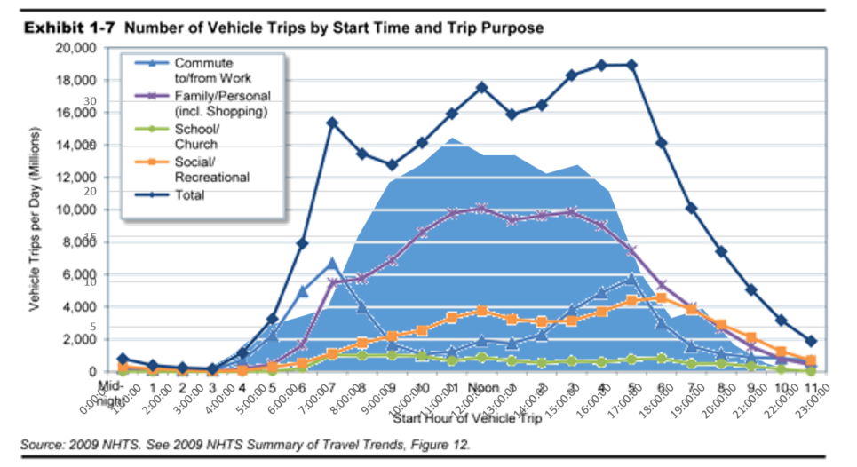
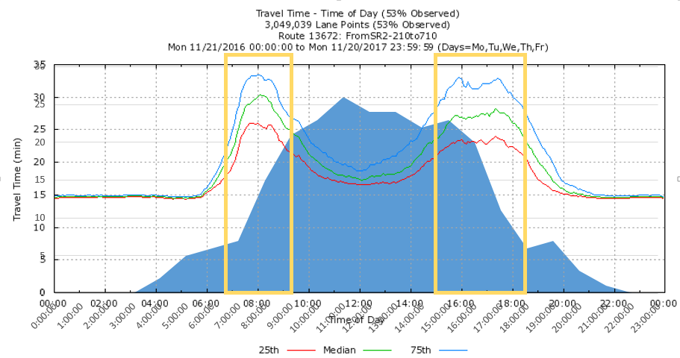
LMFS Time of Day
  Deliveries peak during business hours in the middle of the day
  Follows general travel trends but more concentrated before and after commuting hours (delivery in-transit hours)
  Deliveries traveling during peak congestion periods

Slide 13
Toolbox of Strategies
LMF Delivery Strategy Categories
  Curb Area
    Curb Loading Areas
    Manage Curb Demand
    Shared Space
    Operating Hours
    Restricted Locations
  Delivery Cos. and Receivers
    Delivery Consolidation
    Building/ Parking Improvements
    Vehicle Options
  Application / Implementation
    Enforcement
    Technology
    Education

Slide 14
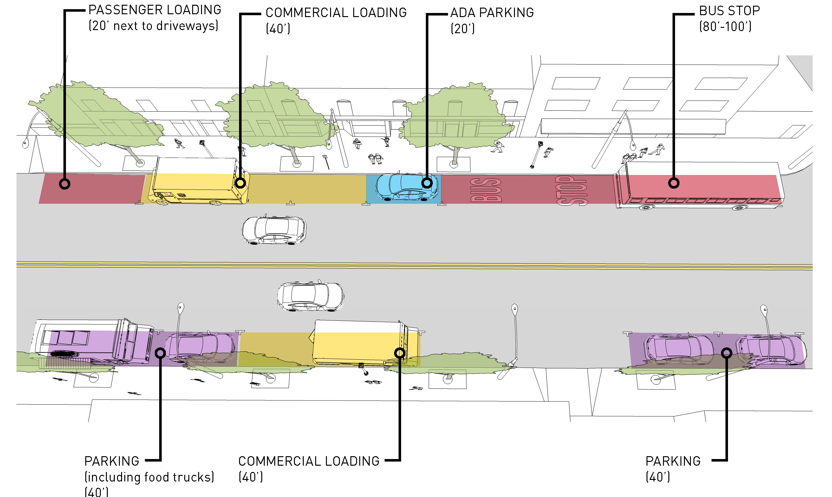
Recommendations – Toolbox of Strategies
Toolbox of Strategies Example –Code the Curb

Slide 15
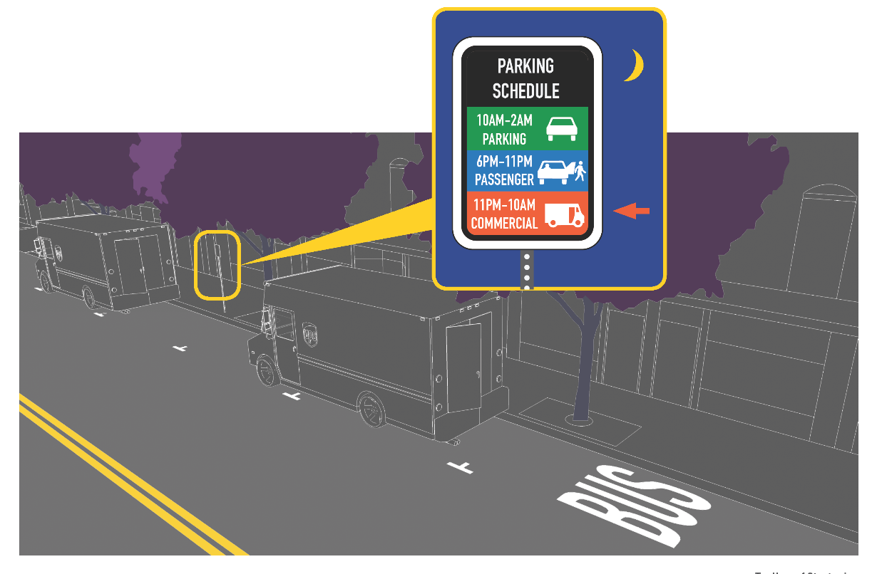
Recommendations – Toolbox of Strategies
Toolbox of Strategies Example – Off-Hours Delivery

Slide 16
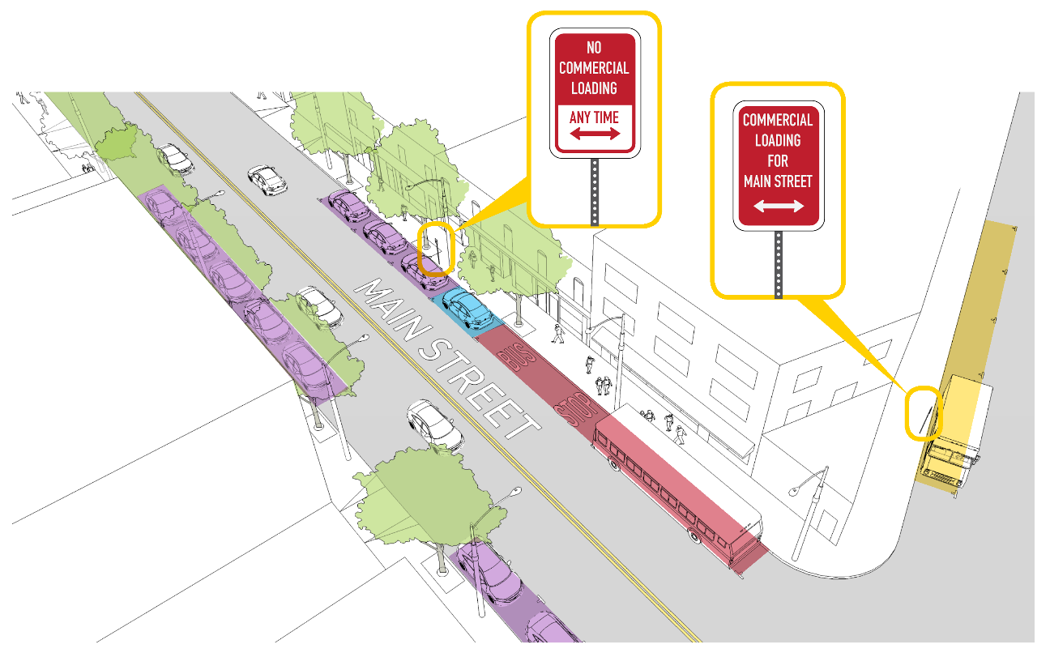
Recommendations – Toolbox of Strategies
Toolbox of Strategies Example – Delivery Restriction to Certain Streets

Slide 17
Thank you!
Annie Nam
NAM@scag.ca.gov
213-236-1827

